Slide 1
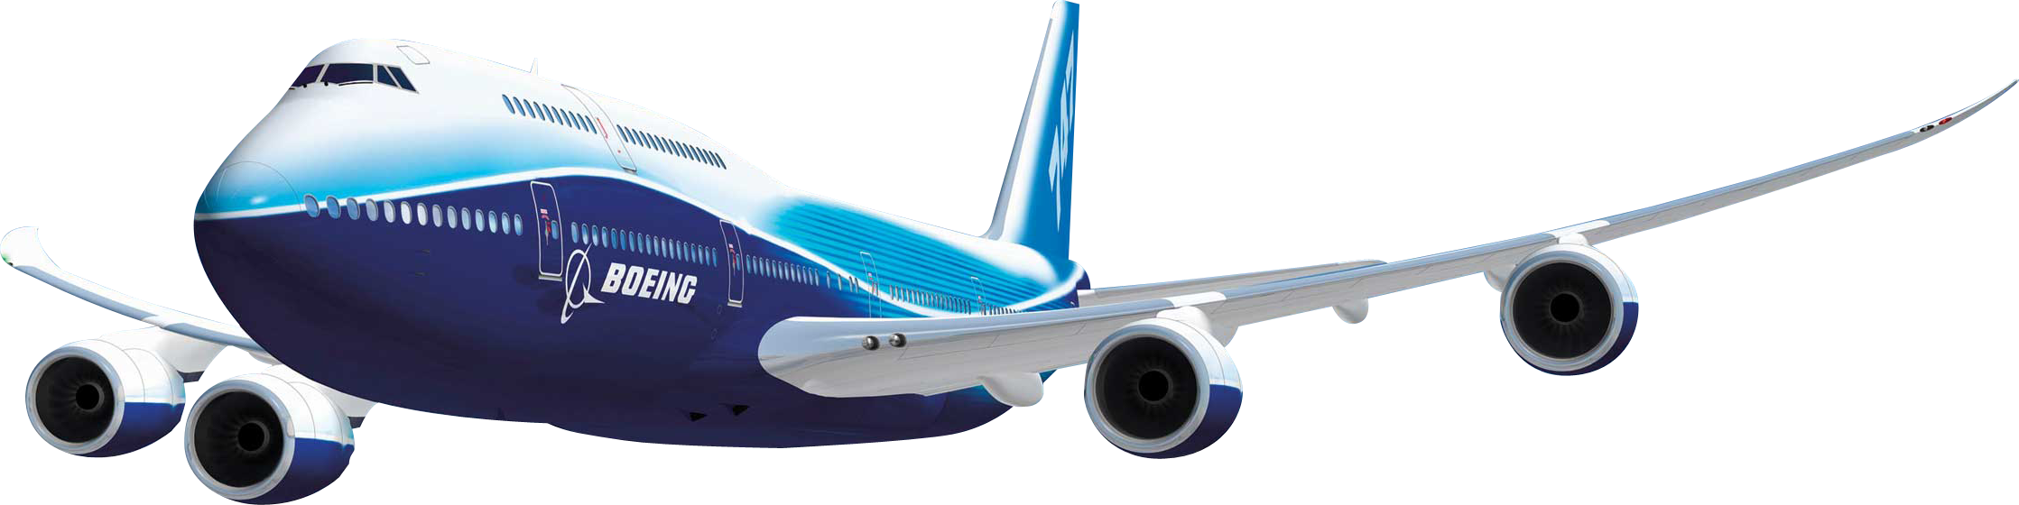
FLIGHT DELAY MAP
Cengiz Imga
Data Scientist, Aviation Background, Industrial Engineer

Slide 2
OUTLINE
FLIGHT DELAY TIME
What is Delay Time ?
What Causes Delay Time ?
Results of Delay
PROBLEM STATEMENT
DATA EXPLORING
Data
Flight Volume per Airport
Domestic Flight Network of Airlines
Airports Departure Delay Performance
Airlines Departure Delay Performance
Average Delays of Airlines by Location
MODEL RESULTS
NEXT STEPS

Slide 3
1- FLIGHT DELAY TIME
1.1 What is Delay Time ?
Let say:
Scheduled Dep Time : 15:20
Leave from the Gate : 15:40
Take off time : 16:00
Delay: 20 minutes

Slide 4
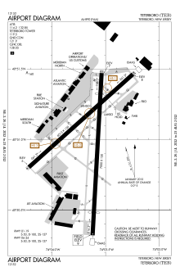
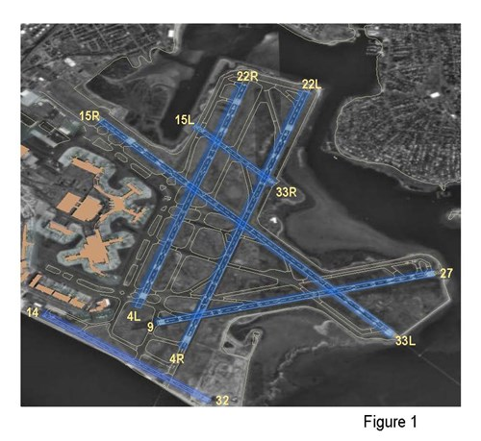
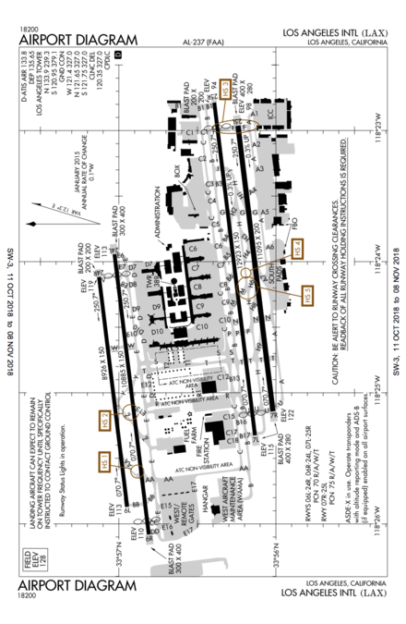
1.2 What Causes Delay Time ?
Airport capacity (number of gates, number of slots, parking area, Design of the Runways )

Slide 5
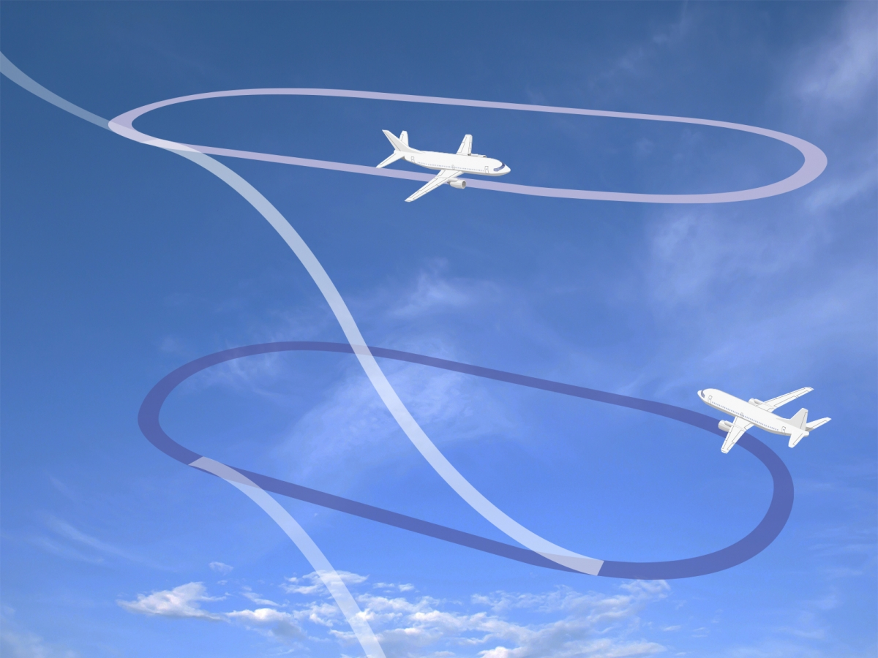
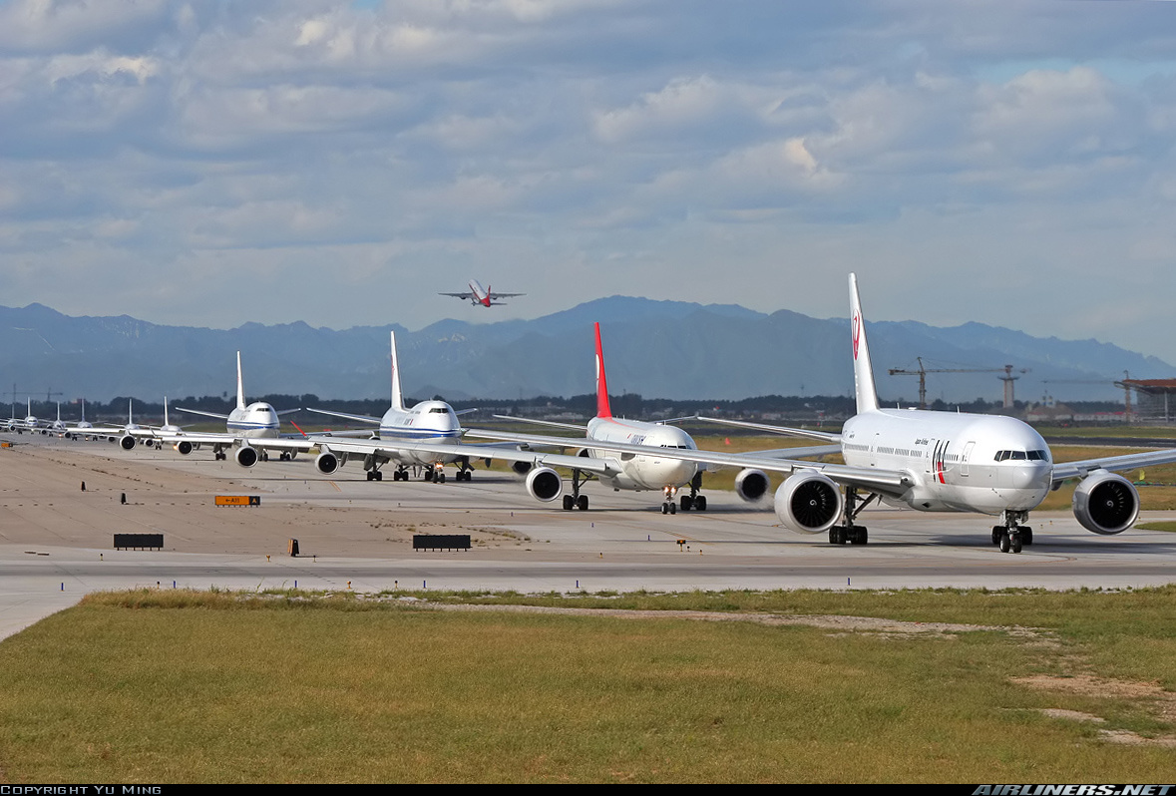
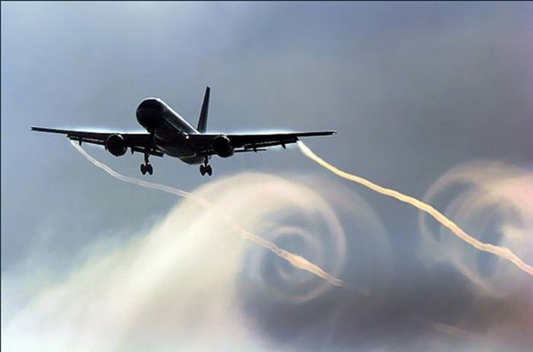
1.2 What Causes Delay Time ?
Origin and Destination airport traffic/slot
Carrier delays
late arriving
technical issues
ground operations
crew problems

Slide 6
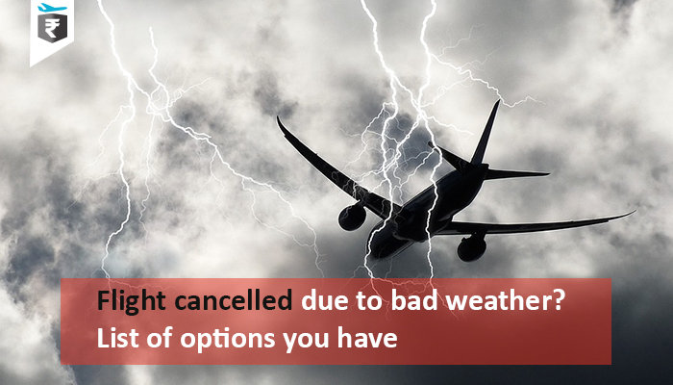
1.2 What Causes Delay Time ?
Weather Conditions

Slide 7
1.3 Results of Delay
Inconveniencing passengers
Cost for Airlines

Slide 8

2- PROBLEM STATEMENT
Predict the delay of each flight by using:
Scheduled departure flight info (Y,M,D)
Origin & Destination airports
Weather conditions for Origin Airport

Slide 9
3- DATA EXPLORING
3.1 Data
Data covers 2016 March - 2019 February
ALL AIRPORTS:
358 airports
358 Destination Airports
18 airlines
18 Million rows of data
TOP BUSIEST 5 + BOS:
6 Origin Airports (ATL,ORD,LAX,DFW,JFK,BOS)
358 Destination Airports
18 airlines
4 Million rows of data

Slide 10
3- DATA EXPLORING
3.1 Sample Data
Flight Data
Weather Data
Merged Data

Slide 11
3- DATA EXPLORING
3.2 Flight Volume per Airport

Slide 12
3- DATA EXPLORING
3.3 Domestic Flight Network of Airlines (UA,AA,DL)

Slide 13
3- DATA EXPLORING
3.4 Airports Departure Delay Performance

Slide 14
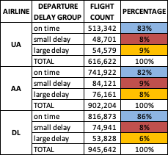
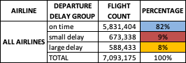
3- DATA EXPLORING
3.5 Airlines Departure Delay Performance

Slide 15
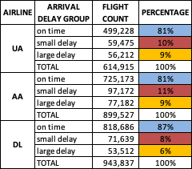
3- DATA EXPLORING
3.5 Airlines Departure Delay Performance
If the departure percentage of "on time" flights is higher than arrival percentage of "on time" flights, there could be two possible reasons:
Ground operations team works efficiently, often before the planned time, or, the airline gives extra time for turnaround operations.

Slide 16
3- DATA EXPLORING
3.6 Average Delays of Airlines by Location
Data: Year 2018

Slide 17
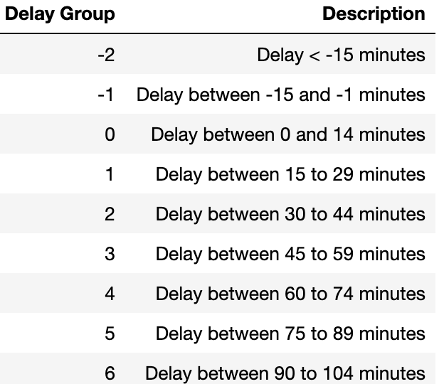
4- MODEL RESULTS
LINEAR REGRESSION:
Target: predict the exact time of the delay
Features : all categorical
R^2 score : %12
CLASSIFICATION:
Target: define classes for delay time and predict classes
Features : all categorical
Baseline: %60
Scores: All models predict baseline
Random Forest: Overfit
AdaBoost: Baseline
Logistic Reg: Baseline
SVC: Baseline

Slide 18
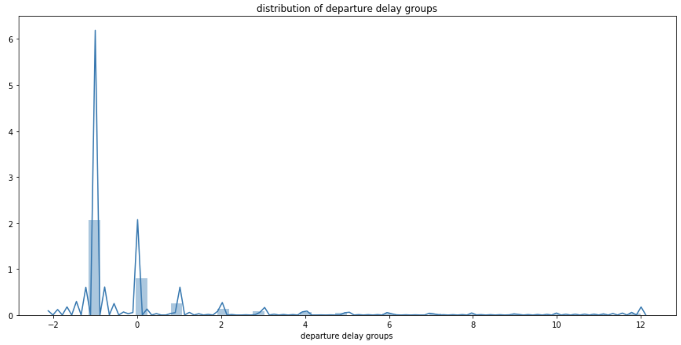
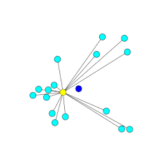
4.1 ACTUAL DISTRIBUTION
The yellow point is the model output and the dark blue point is the dominant feature which is -1 here. The Model tends to predict the most frequent class. This is the biggest challenge of the model.
Data: Year 2018, 7M domestic departure flights of all airports

Slide 19
5- NEXT STEPS
Add Weather Conditions for all destinations (time-efficiency issue. Here scraped ~%1 of the weather data)
Add Ground Time
Add aircraft Fleet Type
Carrier delays
Number of slots of airports
Average ticket price could be used(hint for differentiating service type carrier)
Redefine the delay time : add taxi out time to delay time

Slide 20

for your time !
View my work here on github:
https://github.com/cimga
Data Sources:
https://www.transtats.bts.gov/databases.asp?Mode_ID=1&Mode_Desc=Aviation&Subject_ID2=0
https://darksky.net/dev

